Slide 1
LACE Risk Model as a strategy to improve Readmission Rates at Adventist Health
Carolina Heimann and Joseph Cawood
August 31, 2018
Notes:
J

Slide 2
Introduction
What is LACE:
Index that identifies patients that are at risk for readmission or mortality within 30-days of discharge.
We are going to present:
how LACE can help AH achieve its vision
how LACE fits in our processes
how leadership can support the initiative
Notes:
J
Briefly introduce the concept
“Over the next 15 minutes I will introduce a risk score that will help us predict the risk of inpatient readmissions. I will lay out the need for change, introduce you to the model, and discuss how you will play a role in the success of this effort.”
I frequently see analysts spend too much time setting the stage and defining the need for change (next section). Do not fall into this trap. You will run out of time and lose your opportunity to explain the model and how it will help!

Slide 3
Why is it important?
Readmission is a metric that affects:
Financial Strength
Patient Experience
Top Clinical Performance
Vision: Transform the health experience of our communities by improving health, enhancing interactions and making care more accessible.
Notes:
C
Spend a few minutes establishing a fact based need for change. Use existing organizational performance metrics, published studies, and current organizational problems to frame the need for change. Do not introduce editorial or build connections to the future yet. You are using facts to explain the current state.
Again, spending too much time justifying the need for change is the most common analyst presentation trap I witness! Your audience already knows the problems if they work inside the organization. Use this to pinpoint which specific pain points your model will help address.

Slide 4
Impact of change
FS: Increased financial stewardship
Do more with reimbursement, ward off potential Federal/State penalties
E.g. CMS to reduce payments to IPPS hospitals with excess readmissions (Readmissions Reduction Program Section 3025)
PE: Longitudinal transparency of care (Hospital to Office)
Trust in the discharge process
TCP: YTD Readmission rate: 8.7% (n= 2945)
Proposed 1-yr reduction Goal: 4% (n= 143)
Notes:
C
Build the connection between inaction and the future state with a focus on building the emotional need for change. Connect current problems to likely / plausible future consequences.
CMS Detail: https://www.cms.gov/medicare/medicare-fee-for-service-payment/acuteinpatientpps/readmissions-reduction-program.html

Slide 5
Impact of change
Consequences of maintaining status quo
Patient perception/market share decrease
Penalized by payers
e.g. Federal, State, or Private
Limiting growth opportunities
Reduced payments impact financial strength to expand into new services
Notes:
C
Build the connection between inaction and the future state with a focus on building the emotional need for change. Connect current problems to likely / plausible future consequences.

Slide 6
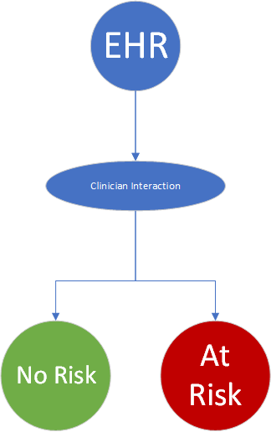
Proposed Solution
What does it do?
Risk classifies patients based on data available in each patient record
Where it fits in the process?
Point-of-care - Acute/Clinic
Hospitalist -> Case Managers -> Primary Care
What is the outcome?
Patient empowerment to live healthy
Better resources management
Notes:
C
Promote Defendable Research with models of Reduction in population readmission
Repurposing information that is already collected, so we can identify patients that have a higher risk of readmission.
Explain the solution at a high level before going into detail.
Skipping the high level and jumping straight to the detail is the second most frequent analyst presentation mistake I see. Give your audience the big picture first so they can better understand and relate to the component parts. This will save you from interruptions and increase their understanding.
The bulk of your presentation should focus on the solution (this section plus the next two)

Slide 7
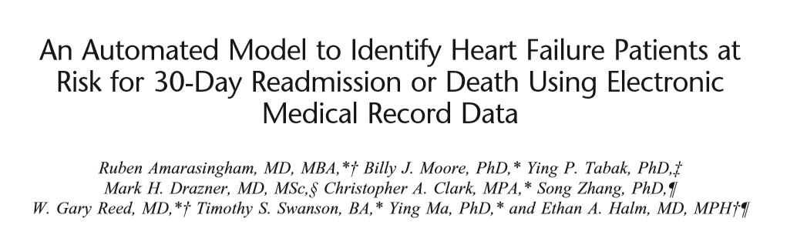
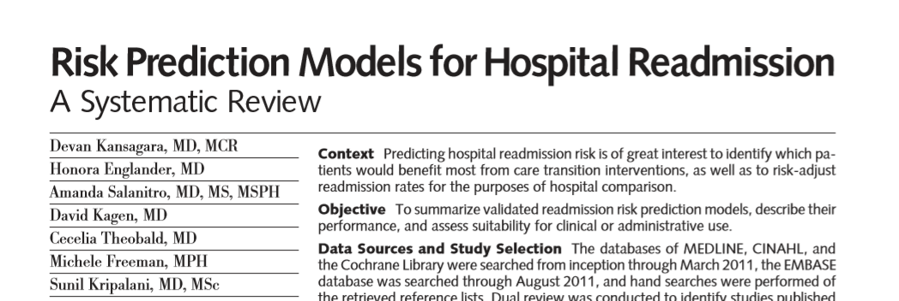
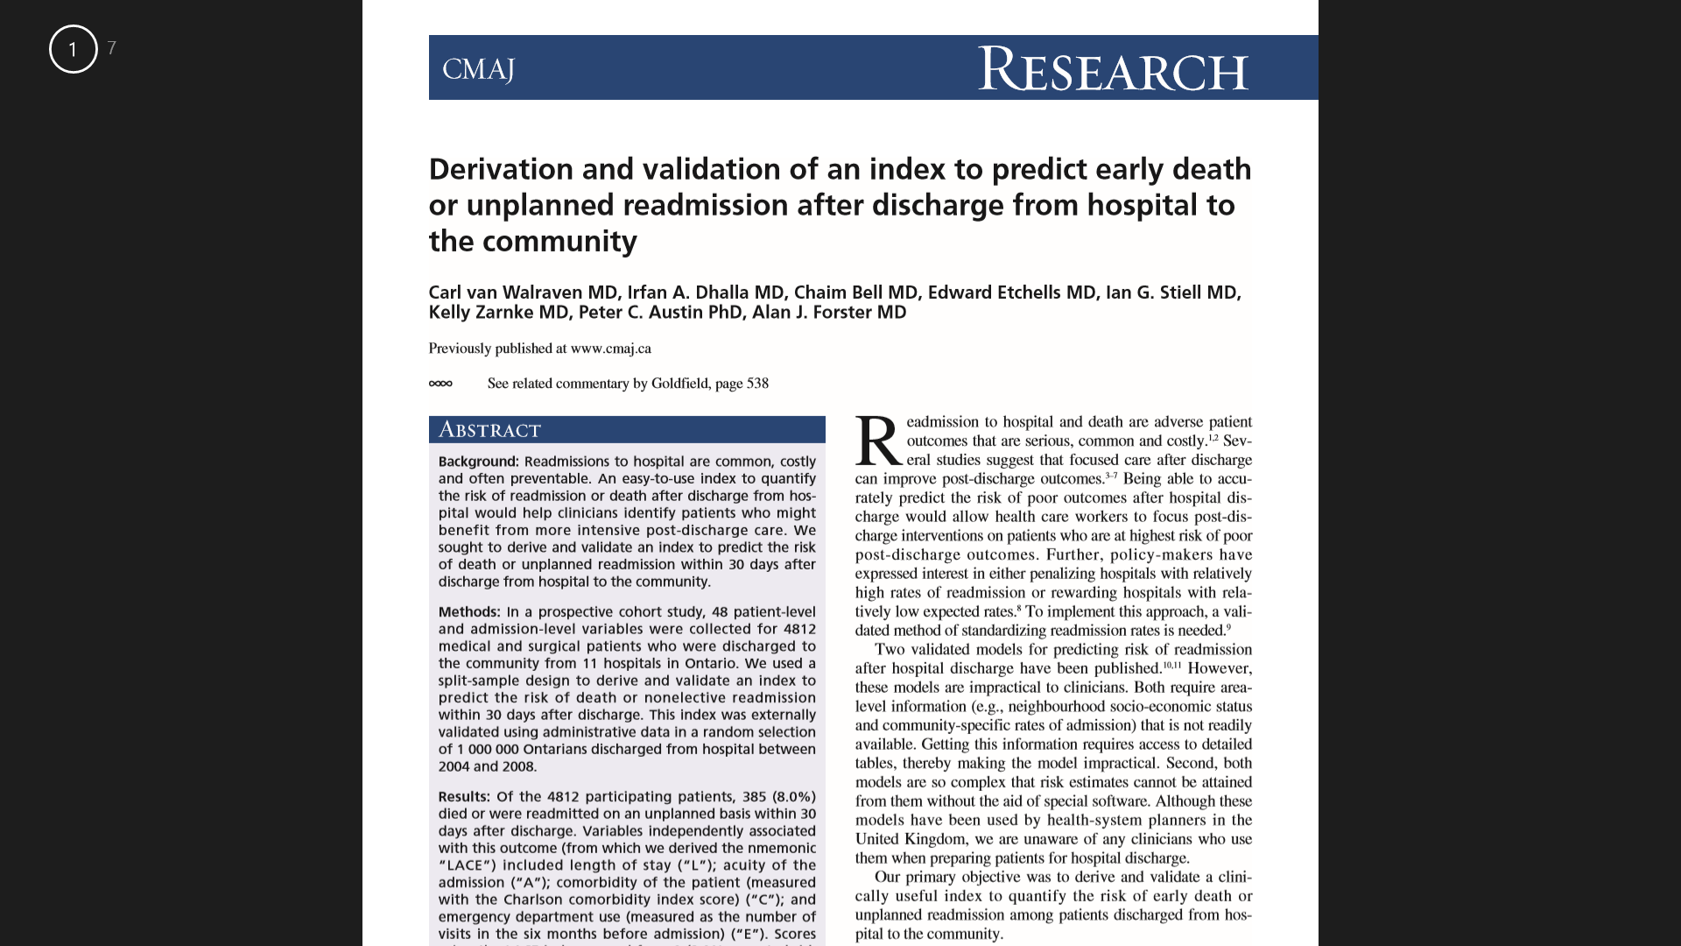
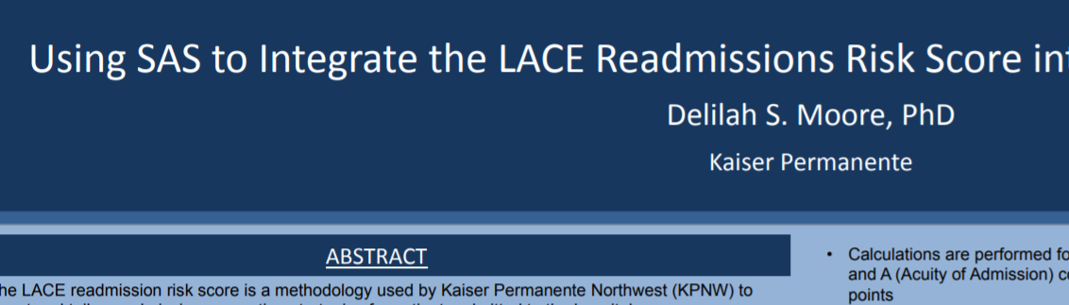
Notes:
C
Promote Defendable Research with models of Reduction in population readmission
Repurposing information that is already collected, so we can identify patients that have a higher risk of readmission.
Explain the solution at a high level before going into detail.
Skipping the high level and jumping straight to the detail is the second most frequent analyst presentation mistake I see. Give your audience the big picture first so they can better understand and relate to the component parts. This will save you from interruptions and increase their understanding.
The bulk of your presentation should focus on the solution (this section plus the next two)

Slide 8
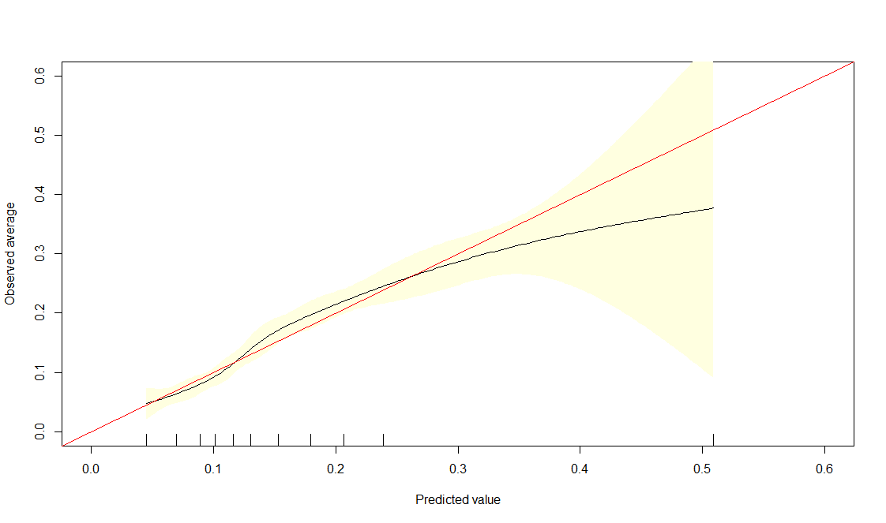
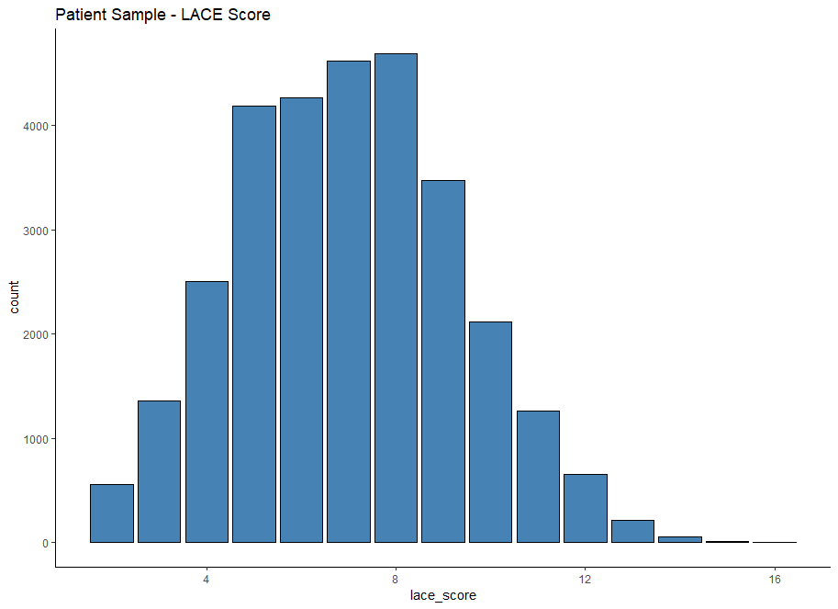
What is LACE+?
Length of Stay | Acuity of Admission | Comorbidities | ED visits last 6 months
Pharmacological - Warfarin Rx upon discharge
Data Source: Cerner Revenue Cycle/Claims Data
L → Discharge Disposition - Admitting/Discharge date/times
A → Patient visit/encounter table(s)
C → ICD9/ICD10 diagnosis/problem table
E → Patient visit/encounter table(s)
Spread of patients LACE Scores from 2014
Measure of accuracy when implemented
Model Performance - Observed vs. Predicted Readmission Risk
← Accuracy Threshold
To classify readmissions
Range of Accuracy
Probability to predict Readmission
*Data Timeframe - 10 months (2014)
Notes:
J
Spend time explaining the key components and functions of your model.
It is important that your audience understand the sources of data, calculations, and logic. Using organizational examples and organizational data works better than “dummy data” and pure mathematical calculations.
This of this section as 25% sales pitch, 25% audience confidence building, and 50% end user training.
Length of Stay - total days between admission to discharge in an acute setting
Acuity - Was the patient admitted to hospital via the emergency department
Comorbidities - Myocardial Infarction & Dementia
ED Visis in the Last six months
+ Rx scripts/Management of Warfarin at discharge
The probabilities are converted into a ratio, and to interpret the coefficients in terms of odds, we need to exponentiate them.
(Intercept) L_score A_score3 C_score E_score warf_disc
0.02575574 1.35058199 1.97811444 1.15972174 1.13608912 1.06314944

Slide 9
Expectations and needs
Expected impact
Decrease in rates of readmission
Improve the discharge decision process
Resources to make this project happen
xx hours of our analytical team
xx hours from clinicians that are involved in the discharge process
What we need from you
Support in the initial contact with clinicians champions that are going to be involved in this project - by memo and participation in the first meeting.
The results of the LACE Score are dependent on the level of utilization from clinicians. We want to engage them in the process to make sure that we’ll deliver this information in the best possible way. Your support and endorsement are key for us to achieve this.
Notes:
J
End with action!
Specifically detail what you need your audience to do in order to make this effort a success.
Think of this as the positive benefits that offset the negative consequences you highlight earlier.
Leave your audience with a clear sense of what they need to do individually to drive success when the leave the room.

